Slide 1
3.2 Logic Gates and Logic Circuits
Use the following logic gate symbols:
NOT AND OR
NAND NOR XOR
Understand and define the functions of :
NOT, AND, OR, NAND, NOR and XOR (EOR) gates
Construct the truth table for each of the logic gates above
Construct a logic circuit
Construct a truth table
Construct a logic expression
Notes and guidance

Slide 2
Today
Everything on syllabus
Understand: What is a logic gate
Able: Draw truth tables
Answer: Which gate has only 1 input

Slide 3
1.3.1 – Logic Gates
Use Logic Gates to create electronic circuits
Understand and define logic gates
AND
OR
NOT
NAND
NOR
XOR
EOR
Truth Tables

Slide 4
Today
Understand : What are logic gates
Able : Identify logic gates
Answer : How many inputs does NOT have

Slide 5
What is a logic gate?
Why do computers use binary?
Because electricity can be either on or off, 1 or 0
But you must control the flow of electricity
You use logic gates to SHOW how you will control the flow of electricity
You’ll do this in Physics also.

Slide 6
6 types
AND
OR
NOT
NAND
NOR
XOR (sometimes called EOR)

Slide 7
AND
Two inputs
One output
Input 1 AND Input 2 must be on for Output to be ON
Written as A . B = Output
Input A | Input B | Output
0 | 0 | 0
0 | 1 | 0
1 | 0 | 0
1 | 1 | 1

Slide 8
OR
Two inputs
One output
Input 1 OR Input 2 must be on for Output to be ON
Written as A + B = Output
(yes I know using + is stupid for OR)
Input A | Input B | Output
0 | 0 | 0
0 | 1 | 1
1 | 0 | 1
1 | 1 | 1

Slide 9
NOT
ONE inputs
One output
If Input in OFF then output is ON
If Input is ON then output is OFF
Written as Ā
Input A | Output
0 | 1
1 | 0

Slide 10
Quick Quiz
Name 2 logic gates
Name 2 more
And 2 more please
Why do we use logic gates?
Which gate has two inputs?
Which gate has one input
What does + mean?
Which gate needs to have input 1 and Input 2 on for output to be on?
Which gate has one output?
Which gate is simply the opposite of the input?
What are the names of the table?

Slide 11
NAND
Stands for NOT AND
Two Inputs
One Output
Output is ON unless both inputs are ON
Written as A . B = Output
Input A | Input B | Output
0 | 0 | 1
0 | 1 | 1
1 | 0 | 1
1 | 1 | 0

Slide 12
NOR
Stands for NOT OR
Two Inputs
One Output
If any Input is ON then output is OFF
Written as A + B = Output
Input A | Input B | Output
0 | 0 | 1
0 | 1 | 0
1 | 0 | 0
1 | 1 | 0

Slide 13
XOR or EOR
Stands for Exclusive OR
Two Inputs
One Output
If the Inputs are the same then then output is OFF
Written as A B
Input A | Input B | Output
0 | 0 | 0
0 | 1 | 1
1 | 0 | 1
1 | 1 | 0

Slide 14
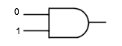

Slide 15
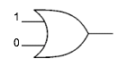

Slide 16
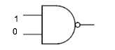

Slide 17
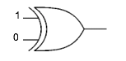

Slide 18
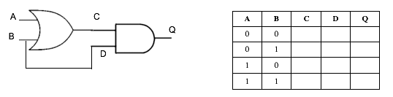

Slide 19
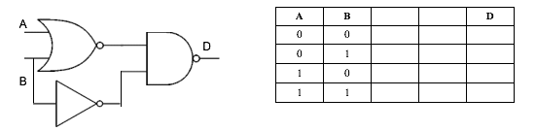

Slide 20
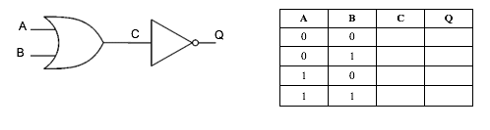

Slide 21
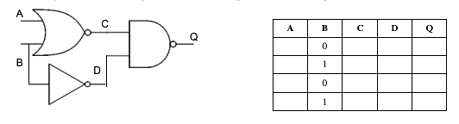

Slide 22
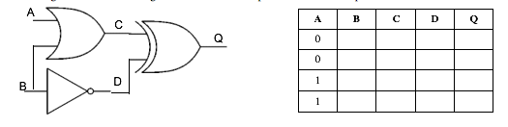

Slide 23
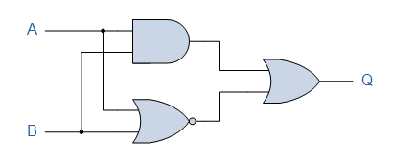

Slide 24
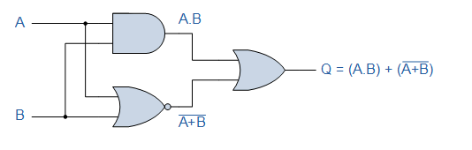

Slide 25
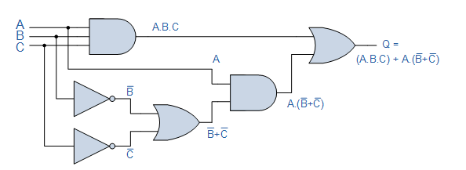

Slide 26
From the exam paper
Draw the logic circuit and truth table for:

Slide 28
Logic circuit and truth table

Slide 29
Answer

Slide 30
Logic circuit and truth table

Slide 31
Answer

Slide 32
Truth table for:

Slide 33
Answer

Slide 34
Test Others
https://academo.org/demos/logic-gate-simulator/
Draw a logic circuit
Make it complicated
Swap places with another student
The other student must write a truth table for YOUR circuit

